Slide 1
Software Specification, Analysis and Design with UML(Unit 3)
-Zijun Li(Vergil)

Slide 2
Overview – B1 to B4
B1: Provide ONE Use Case Diagram
comprehensive
use stereotype
B2: Chose 4 User Case from B1, and provide documentations
non-trivial scenarios/stories
pre/post condition
B3: Describe 4 non-trivial scenarios/stories
B4: Provide an Activity Diagram for 2 non-trivial scenario
control node/swim lanes/conditions

Slide 3
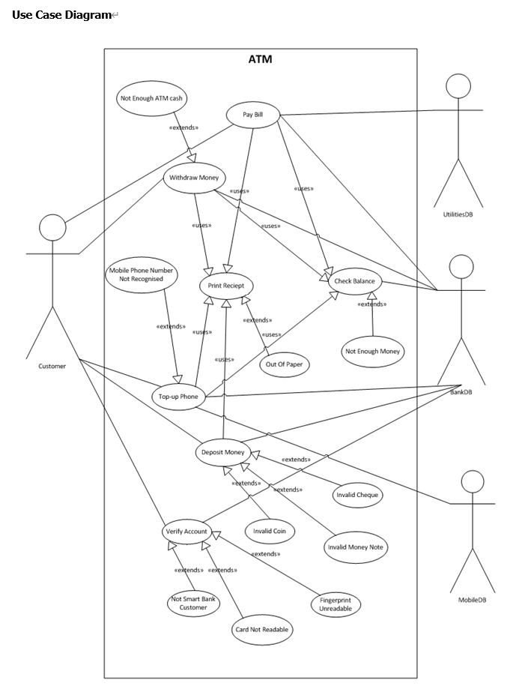
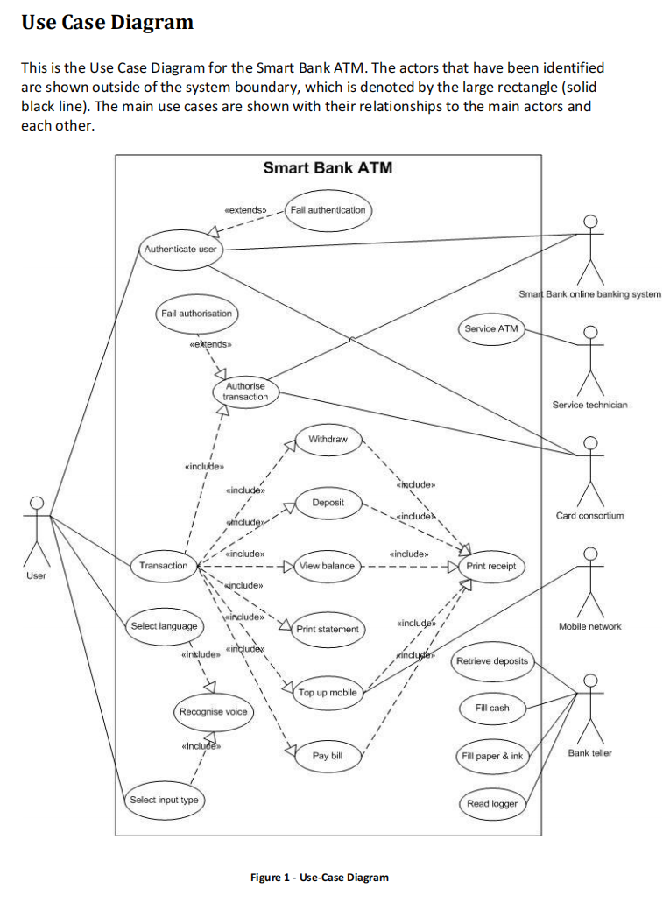
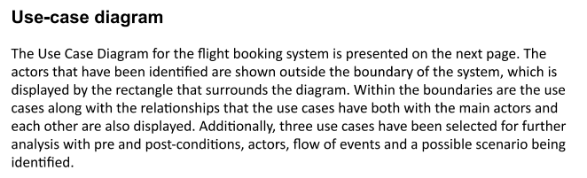
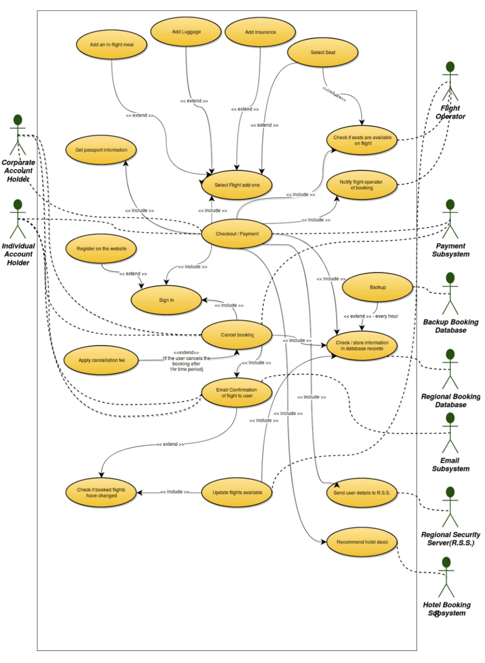
B1-Provide ONE Use Case Diagram
Unit3.2

Slide 4
B2-Chose 4 User Case from B1, and provide documentations
Use Case Specification
- Use Case Name
- Actors
- Entry Condition(pre-)
- Normal behavior
- Exit Condition(post-)
- Exceptions
- Special Requirements(e.g. non-functional)

Slide 5
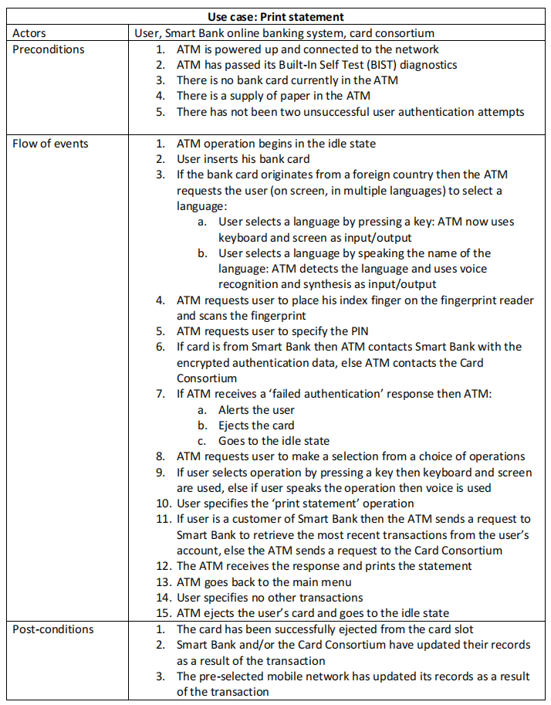
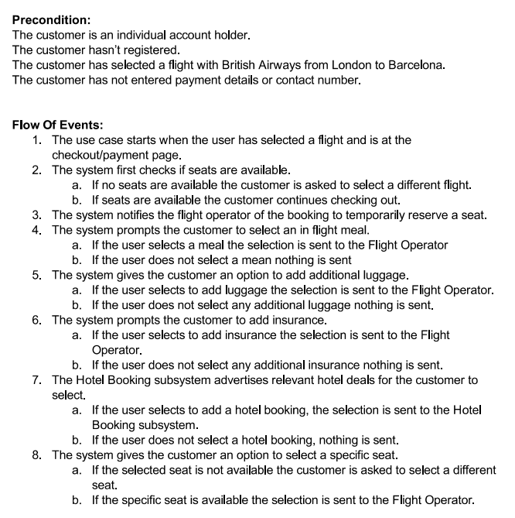
B2-Chose 4 User Case from B1, and provide documentations

Slide 6
B3-Describe 4 non-trivial scenarios/stories
Should be included in B2

Slide 7
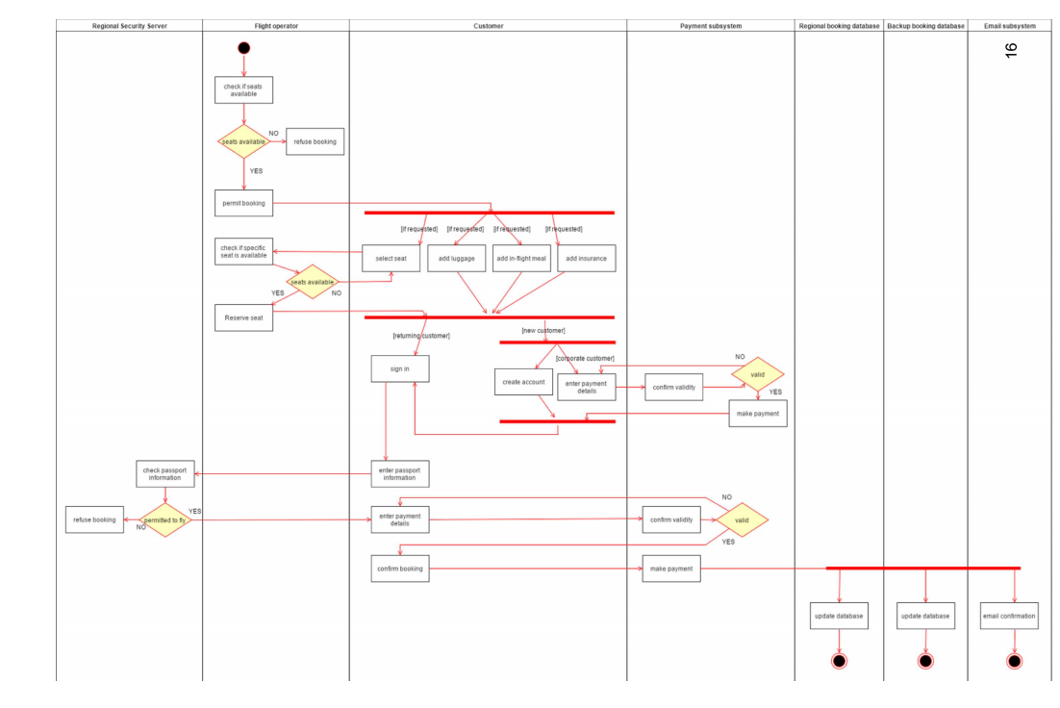
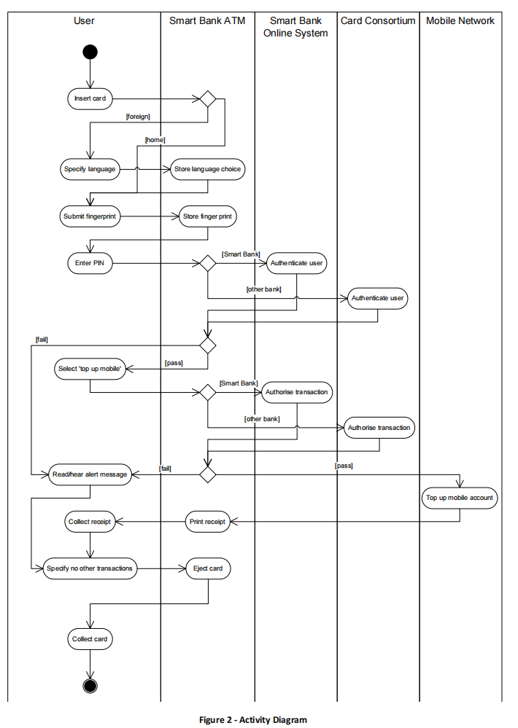
B4- Provide an Activity Diagram for 2 non-trivial scenario

